Slide 1

OOP LAB 4 (11 Oct 22)
Introduction to C#
By: Miss Tia

Slide 2
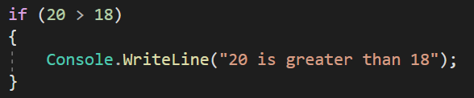
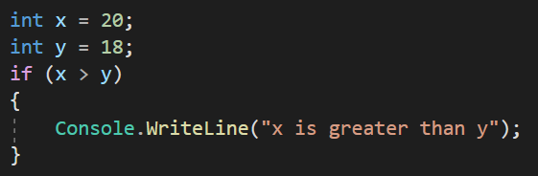
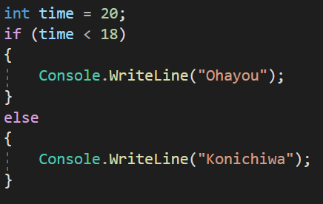

C# Conditions and If Statements
C# has the following conditional statements:
If ... Else. Use if to specify a block of code to be executed, if a specified condition is true
*Note that if is in lowercase letters. Uppercase letters (If or IF) will generate an error
Use else to specify a block of code to be executed, if the same condition is false
Output:

Slide 3
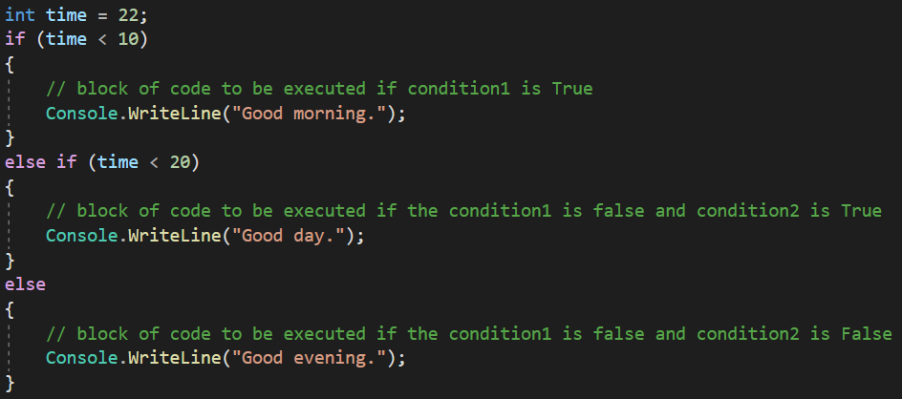

C# Conditions and If Statements
C# has the following conditional statements:
Use else if to specify a new condition to test, if the first condition is false
Output:

Slide 4
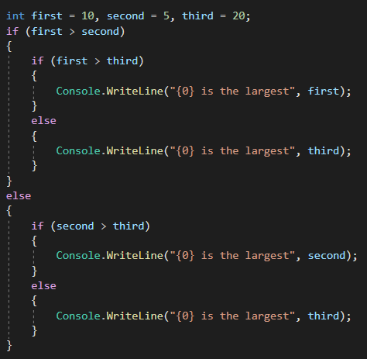
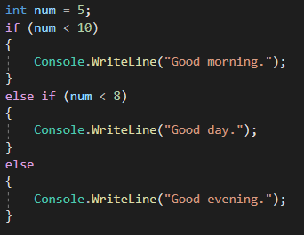

C# Conditions and If Statements
C# has the following conditional statements:
Nested if...else statement.
In a nested if statement, if the outer if statement returns true, it enters the body to check the inner if statement.
Output:

Slide 5
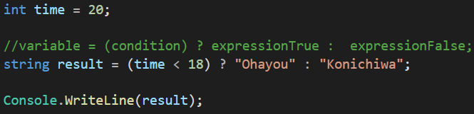
C# Conditions and If Statements
C# has the following conditional statements:
Short Hand If...Else.
Known as the ternary operator because it consists of three operands. It can be used to replace multiple lines of code with a single line. Often used to replace simple if else statements:
Output:

Slide 6
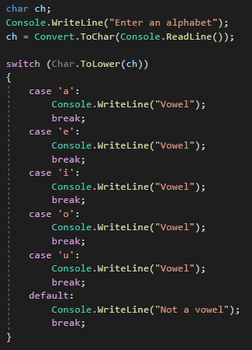
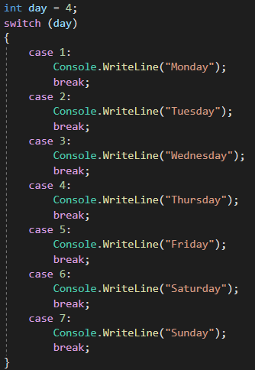
C# Conditions and If Statements
C# has the following conditional statements:
Use switch to specify many alternative blocks of code to be executed
switch statement in C# only works with:
Primitive data types: bool, char and integral type
Enumerated Types (Enum)
String Class
Nullable types of above data types

Slide 7
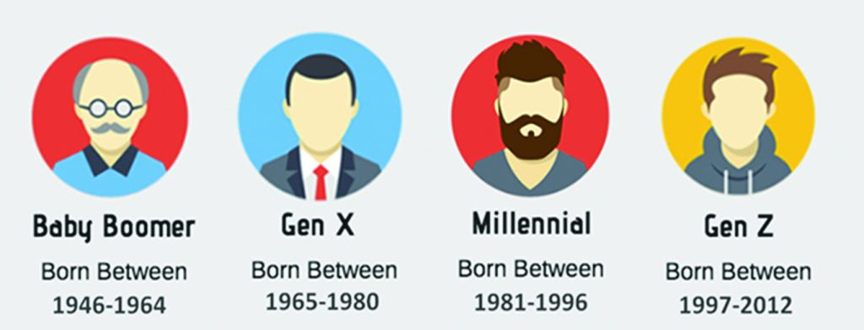
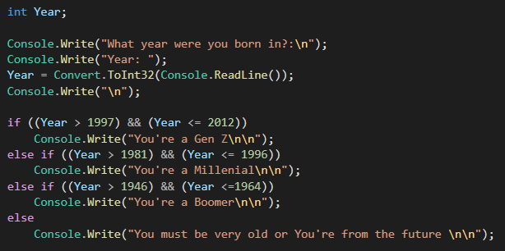
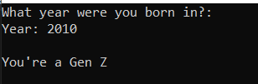
Let the debugging begins
​Exercise: Request an input from user the year they are born, output wether they are Gen Z, Millenial or Boomers

Slide 8
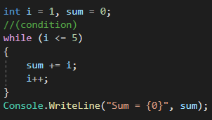
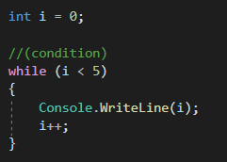
Loops
Loops can execute a block of code as long as a specified condition is reached. Loops save time, reduce errors, and they make code more readable.
C# While Loop
While loop, loops through a block of code as long as a specified condition is True.
The code in the loop will run, over and over again, as long as a variable (i) is less than 5
Output:

Slide 9
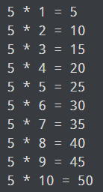
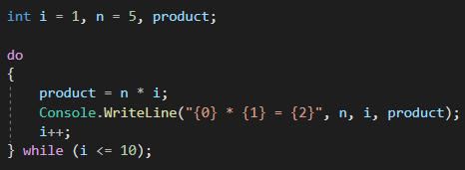
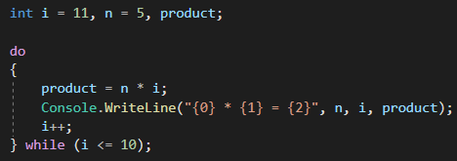
Loops
C# Do/While Loop
Output:
The loop will always be executed at least once, even if the condition is false, then it will repeat the loop as long as the condition is true.
Output:

Slide 10
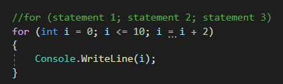

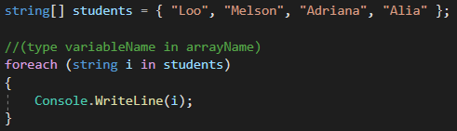

Loops
C# For Loop
When you know exactly how many times you want to loop through a block of code, use the for loop instead of a while loop
Output:
Statement 1 : is executed (one time)
Statement 2 : defines the condition for executing the code block.
Statement 3 : is executed (every time)
C# Foreach Loop
foreach loop, which is used exclusively to loop through elements in an array
Output:

Slide 11
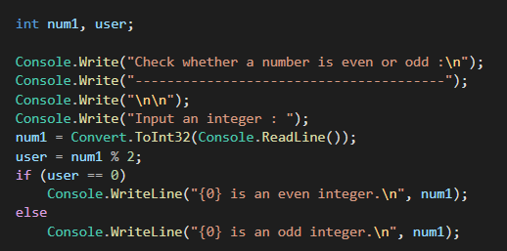

Let the debugging begins
​Exercise: Write a C# Sharp program to check whether a given number is even or odd. You have to use operator (%)
Output:

Slide 12
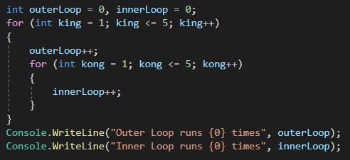

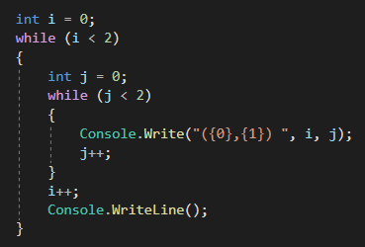

Loops
Nested for loop
A loop within another loop is called nested loop.
As you can see, the outer loop encloses the inner loop. The inner loop is a part of the outer loop and must start and finish within the body of outer loop.
Output:
The outer loop runs for 5 times. Each time the outer loop runs, the inner loop runs for 5 times making it run 25 times.
Nested while loop
Output:

Slide 13
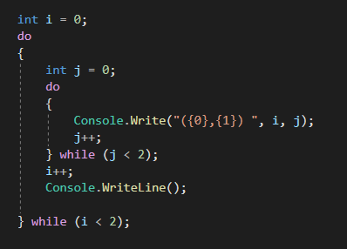

Loops
Nested do while
A loop within another loop is called nested loop.
As you can see, the outer loop encloses the inner loop. The inner loop is a part of the outer loop and must start and finish within the body of outer loop.
Output:

Slide 14
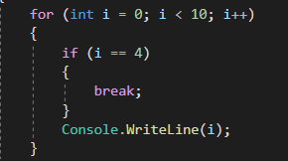

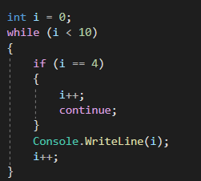

C# Break and Continue
C# Break
The break statement can also be used to jump out of a loop. This example jumps out of the loop when i is equal to 4:
Output:
C# Continue
continue statement breaks one iteration (in the loop), if a specified condition occurs, and continues with the next iteration in the loop.
Output:

Slide 15
Lab 4
​Exercise: debug every loop and decision
If statement
If else
Else if
For loop
While loop
Do while
Mix between loops

Slide 16
THANKS!

